Slide 1
Tech-Driven Solutions for Undertrial Prisoners in India
PIP4004 University Project
Review-1
Batch Number:
CSE-G26
20211CSE0114 | REDDY MASY TEJA
20211CSE0112 | KASTURI DEEPAK
20211CSE0125 | D PHANI BALA JASWANTH
20211CSE0121 | YAGANTI PRAVEN
Under the Supervision of,
Ms.. ROHINI
Assistant Professor
School of Computer Science and Engineering
Presidency University
Roll Number | Student Name
Name of the Program: Computer Science and Engineering(CSE)
Name of the HoD: Dr. Asif Mohammed
Name of the Program Project Coordinator: Mr. Amarnath J L
Name of the School Project Coordinators: Mr. Md Ziaur Rahman

Slide 2
Introduction
In India, undertrial prisoners, who are individuals awaiting trial, often face prolonged detention due to the slow pace of the judicial process. This issue has led to overcrowded prisons and violated fundamental human rights. Tech-driven solutions offer promising ways to address these challenges and ensure more efficient justice. Artificial intelligence (AI) can be employed to assess case backlogs and help prioritize cases based on urgency or severity, ensuring faster resolutions. Digital platforms can facilitate remote court hearings, allowing prisoners to participate without the need for physical transfers, cutting down on delays and travel costs. Blockchain technology can provide transparent, immutable records of cases, reducing the risks of tampering or corruption in the system. Mobile apps and online platforms can give undertrials easier access to legal aid, case tracking, and updates, enabling better-informed prisoners and families. Data analytics can be leveraged to identify trends in case delays, optimize court schedules, and streamline resource allocation within the judicial system. Virtual legal assistance programs can connect undertrials with pro bono lawyers, especially in rural or underserved areas, helping overcome the issue of limited legal representation. Machine learning algorithms could help predict trial dates and estimate case completion times, improving the planning and overall efficiency of the judicial process. These technologies can also enable better coordination between police, courts, and legal bodies, reducing human error. By addressing bottlenecks in the system, such solutions can help ease the overpopulation of prisons, ensure timely justice, and uphold the rights of undertrial prisoners.

Slide 3
Literature Review
Sl.no | Paper Title | Authors | Proposed Model | Results | Drawbacks | Year
1 | AI-Based Case Management System for Undertrial Prisoners | Sharma R., Kumar P. | AI-powered system that tracks case progress and provides real-time updates on trial status. | Reduced case backlogs and improved case tracking accuracy. | Requires integration with court databases for real-time updates. | 2022
2 | Blockchain for Transparent Prisoner Records | Verma K., Das S. | Blockchain-based system for maintaining tamper-proof prisoner records and legal proceedings. | Enhanced transparency and security in case records. | High implementation cost and requires legal framework adaptation. | 2021
3 | IoT-Based Monitoring System for Undertrial Prisoners | Gupta A., Nair V. | IoT-enabled wearables to track prisoners’ movements and ensure compliance with bail conditions. | Improved prisoner tracking and reduced violations of bail terms. | Privacy concerns and risk of device malfunction. | 2023
4 | Machine Learning for Bail Prediction | Mehta P., Roy D. | ML algorithm analyzing previous court cases to predict bail eligibility for undertrial prisoners. | Faster bail recommendations and reduced judicial burden. | Requires large datasets for accurate predictions. | 2022
5 | Automated Legal Assistance Chatbot for Prisoners | Singh R., Bose T. | NLP-based chatbot to provide legal aid and guide prisoners on their rights. | Increased legal awareness among undertrial prisoners. | Limited understanding of complex legal queries. | 2023

Slide 4
Literature Review
Sl.no | Paper Title | Authors | Proposed Model | Results | Drawbacks | Year
6 | Blockchain for Transparent Prisoner Records | Verma K., Das S. | Blockchain-based system for maintaining tamper-proof prisoner records and legal proceedings. | Enhanced transparency and security in case records. | High implementation cost and requires legal framework adaptation. | 2021
7 | Digital Prison Management System using Cloud Technology | Patel L., Iyer M. | Cloud-based platform for centralized prisoner data storage and case updates. | Easy access to prisoner information across multiple agencies. | Risk of data breaches and cyber threats. | 2020
8 | Smart Contracts for Bail Transactions | Rao V., Bhatia P. | Blockchain-based smart contracts to automate bail payment processing. | Faster bail approvals and reduced corruption. | Needs legal and banking sector adaptation. | 2023
9 | Data Analytics for Identifying Wrongful Detention Cases | Agarwal M., Dutta R. | Data-driven analysis of prisoner records to detect wrongful detentions. | Identified 15% cases with potential legal discrepancies. | Accuracy depends on quality of legal data. | 2021
10 | Automated Legal Assistance Chatbot for Prisoners | Singh R., Bose T. | NLP-based chatbot to provide legal aid and guide prisoners on their rights. | Increased legal awareness among undertrial prisoners. | Limited understanding of complex legal queries. | 2023

Slide 5
Existing method Drawback
Limited Focus on Prisoner Rights & Communication
The existing system primarily focuses on AI-driven security measures, such as monitoring inmate phone calls and analyzing CCTV footage. However, it does not address the communication barriers between undertrial prisoners, lawyers, and judicial authorities.
Lack of Transparency
AI-based surveillance systems monitor and analyze behavior, but they do not provide undertrial prisoners with direct access to case updates or legal resources. This can lead to misinformation and uncertainty about legal proceedings.
No Legal Assistance or Case Management Features
The current system does not facilitate real-time legal consultations, case tracking, or document sharing between lawyers and prisoners, which are essential for effective legal representation.
Focus on Crime Prevention Rather Than Legal Aid
While AI-driven security systems enhance prison surveillance, they do not contribute to ensuring fair trials, legal support, or rehabilitation opportunities for undertrial prisoners.
Lack of AI-Based Legal Support
No AI chatbot or automated system exists to assist prisoners with legal inquiries, which could otherwise help reduce the workload of lawyers and judicial officers

Slide 6
Proposed Method
Secure User Authentication & Role-Based Access
Ensures restricted access for lawyers, judges, and legal representatives.
Provides password recovery and multi-level authentication for security.
Real-Time Communication & AI Legal Assistance
Chat feature for instant messaging between prisoners and lawyers.
AI chatbot assists with legal queries and provides case-related information.
Automated Appointment & Case Management
Lawyers and prisoners can schedule, reschedule, or cancel appointments.
Centralized repository for case updates, legal documents, and hearing dates.
Notification & Document Management System
Sends alerts for upcoming hearings, case progress, and lawyer availability.
Secure storage and retrieval of legal documents for easy access.
Multi-Language Support & User-Friendly Interface
Accessible to users from diverse backgrounds with easy navigation.
Supports multiple languages to ensure inclusivity and ease of use

Slide 7
Objectives
Enhance Communication Between Undertrial Prisoners and Legal Representatives
Provide a real-time chat system to facilitate seamless interaction.
Enable lawyers to update case progress and share legal documents.
Improve Transparency in Legal Proceedings
Ensure prisoners and their families receive accurate case updates.
Reduce misinformation by providing a centralized case management system.
Automate Appointment Scheduling and Case Tracking
Allow prisoners to book appointments with legal representatives.
Notify users about upcoming hearings, case status, and legal deadlines.
Provide AI-Powered Legal Assistance
Integrate an AI chatbot to assist in answering legal queries.
Reduce the workload of judges and lawyers by automating common inquiries.
Ensure Accessibility and Inclusivity
Support multiple languages for diverse users.
Design a user-friendly interface for individuals with limited tech knowledge.

Slide 8
Methodology/Modules
User Authentication & Role-Based Access Control
Secure login and authentication for different user roles (lawyers, judges, prisoners).
Password recovery and multi-factor authentication to ensure data security.
AI-Powered Legal Chatbot
Provides automated responses to legal inquiries from undertrial prisoners.
Assists judges and district attorneys by reducing workload and answering common queries.
Real-Time Chat & Communication System
Enables instant messaging between prisoners and legal representatives.
Ensures secure and confidential communication for legal discussions.
Appointment Scheduling System
Automated scheduling of appointments between prisoners and lawyers.
Prevents scheduling conflicts and ensures timely legal consultations.
Case Management & Tracking
Centralized repository for case details, legal documents, and hearing updates.
Allows lawyers to update case progress and share documents with clients.

Slide 9
Methodology/Modules
Document Storage & Retrieval System
Secure cloud-based storage for case files, court documents, and legal papers.
Easy retrieval and sharing of documents between authorized users.
Notification & Reminder System
Sends alerts for upcoming hearings, case progress, and lawyer availability.
Provides reminders for scheduled appointments and important legal deadlines.
Multi-Language Support & Accessibility
Supports multiple languages to cater to a diverse user base.
Ensures accessibility for users with different levels of technical proficiency.
Data Security & Privacy Protection
Implements encryption and secure access control mechanisms.
Protects sensitive legal and personal data from unauthorized access.
User Profile Management & Personalization
Allows users to manage personal details, preferences, and case history.
Customizable settings for notifications and communication preferences.

Slide 10
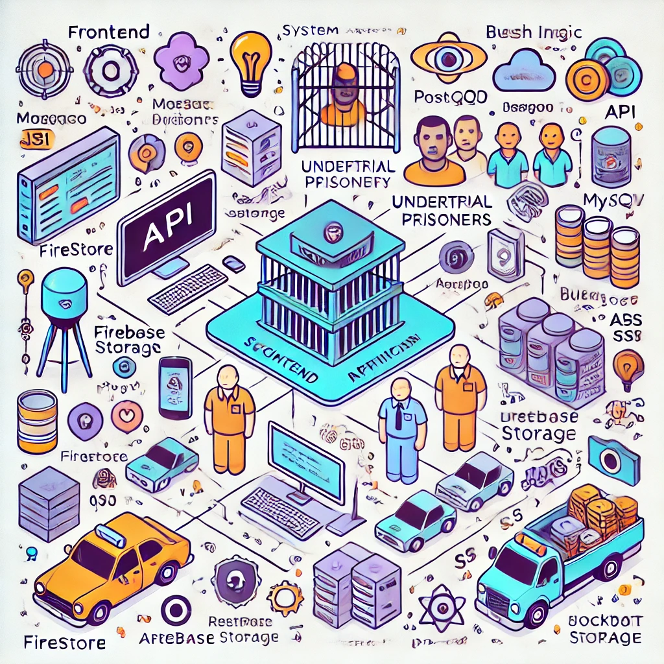
Architecture

Slide 11
software components
Frontend Development:
Technology: Flutter (Dart) / React Native
Purpose: Cross-platform mobile application development (Android & iOS)
Alternative: Native Android (Java/Kotlin) or iOS (Swift)
Backend Development:
Technology: Node.js (Express.js) / Django (Python) / Spring Boot (Java)
Purpose: Handles business logic, authentication, and API requests
Database Management System (DBMS):
Technology: Firebase Firestore / MySQL / PostgreSQL / MongoDB
Purpose: Stores user profiles, case details, chat logs, and appointment records
Authentication & Security:
Technology: Firebase Authentication / OAuth 2.0 / JWT (JSON Web Token)
Purpose: Secure user authentication and role-based access control
Real-Time Communication:
Technology: Firebase Realtime Database / WebSockets (Socket.io)
Purpose: Enables real-time messaging between lawyers and prisoners

Slide 12
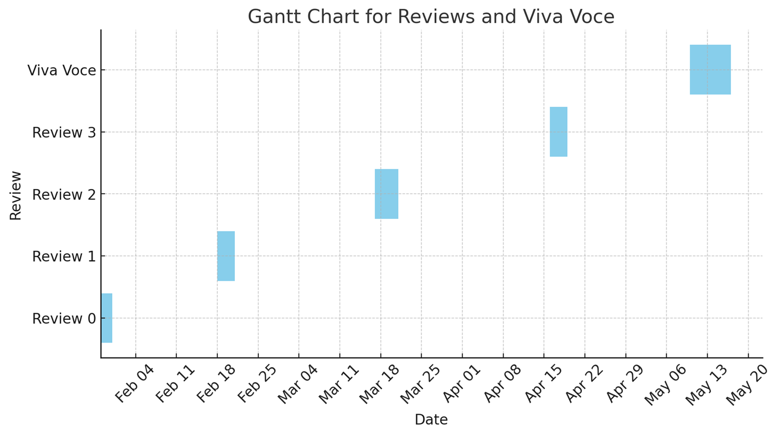
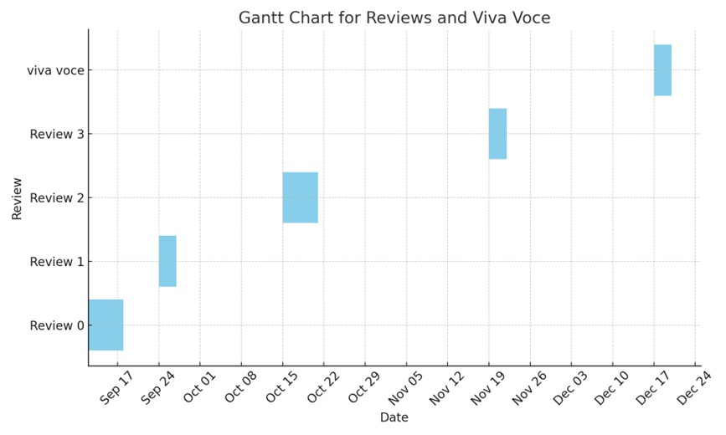
Timeline of Project

Slide 13
Expected Outcomes
Enhanced Communication – The platform will enable seamless communication between undertrial
prisoners and their legal representatives through real-time messaging and updates.
Improved Case Transparency – Prisoners and their families will have access to up-to-date case details,
reducing misinformation and improving legal awareness.
Efficient Appointment Scheduling – Automated scheduling will minimize conflicts and delays, ensuring
better coordination between lawyers and clients.
AI-Powered Assistance – The chatbot will provide quick responses to legal inquiries, reducing the workload
for judges and attorneys.
Secure and Role-Based Access – Strong authentication mechanisms will ensure only authorized users can
access sensitive legal data.
Streamlined Legal Document Management – The application will facilitate easy storage, retrieval, and
sharing of legal documents between clients and lawyers.

Slide 14
Increased Legal Awareness – Prisoners will receive personalized legal advice, improving their understanding of rights and legal processes.
Better Rehabilitation Support – Access to legal and medical services will contribute to the overall well-being and rehabilitation of undertrial prisoners.
Reduced Workload for Legal Professionals – Automation of routine tasks like case updates and appointment scheduling will allow lawyers to focus on legal strategy.
Scalable and Future-Ready Platform – The system will be designed for easy expansion to include additional legal aid services, AI enhancements, and multi-language support.

Slide 15
Conclusion
The technology-driven support system for undertrial prisoners integrates key components to enhance legal assistance, communication, and case management efficiency. The primary components of the system include:
AI-Powered Chatbot: Assists legal professionals and prisoners by answering queries and providing legal information, reducing workload and response times.
Secure User Authentication: Ensures role-based access control for prisoners, lawyers, and judges, maintaining data security and privacy.
Appointment Management System: Streamlines scheduling between clients and legal representatives, preventing conflicts and ensuring timely consultations.
Case Management Module: Tracks case progress, stores legal documents, and provides real-time updates to prisoners and their families.
Real-Time Communication: Enables direct messaging between prisoners and lawyers for seamless legal discussions and case updates.
Legal Document Repository: Centralized storage for case-related documents, ensuring easy access, retrieval, and secure sharing.
Integration with Cloud Database: Ensures efficient data management, allowing secure storage and retrieval of case information.

Slide 16
Github Link
Github Link:
https://github.com/deepak/Tech-Driven Solutions for Undertrial Prisoners in India

Slide 17
References
G. Duwe and K. Kim, ‘‘Out with the old and in with the new? An empirical comparison of supervised learning algorithms to predict recidivism,’’ Criminal Justice Policy Rev., vol. 28, no. 6, pp. 570–600, Jul. 2017.
M. Mohandes, M. Deriche, and S. O. Aliyu, ‘‘Classifiers combination techniques: A comprehensive review,’’ IEEE Access, vol. 6, pp. 19626–19639, 2018.
J. van Dijk, S. Kalidien, and S. Choenni, ‘‘Smart monitoring of the criminal justice system,’’ Government Inf. Quart., vol. 35, no. 4, pp. S24–S32, Oct. 2018.
S. Nakayama, E. Krasner, L. Zino, and M. Porfiri, ‘‘Social information and spontaneous emergence of leaders in human groups,’’ J. Roy. Soc. Interface, vol. 16, no. 151, Feb. 2019, Art. no. 20180938.
F. Ishowo-Oloko, J.-F. Bonnefon, Z. Soroye, J. Crandall, I. Rahwan, and T. Rahwan, ‘‘Behavioral evidence for a transparency–efficiency tradeoff in human–machine cooperation,’’ Nature Mach. Intell., vol. 1, no. 11, pp. 517–521, 2019.

Slide 18
References
J. Qin, Y. Chen, W. Fu, Y. Kang, and M. Perc, ‘‘Neighborhood diversity promotes cooperation in social dilemmas,’’ IEEE Access, vol. 6, pp. 5003–5009, 2018
J. Reiman and P. Leighton, Rich Get Richer and the Poor Get Prison: Ideology, Class, and Criminal Justice. Evanston, IL, USA: Routledge, 2015.
Y. Li, J. Zhang, and M. Perc, ‘‘Effects of compassion on the evolution of cooperation in spatial social dilemmas,’’ Appl. Math. Comput., vol. 320, pp. 437–443, Mar. 2018. IJCRT2404142 International Journal of Creative Research Thoughts (IJCRT) www.ijcrt.org b264 www.ijcrt.org © 2024 IJCRT | Volume 12, Issue 4 April 2024 | ISSN: 2320-2882
C. Xia, S. Ding, C. Wang, J. Wang, and Z. Chen, ‘‘Risk analysis and enhancement of cooperation yielded by the individual reputation in the spatial public goods game,’’ IEEE Syst. J., vol. 11, no. 3, pp. 1516–1525, Sep. 2016.
Z. Rong, Z.-X. Wu, and G. Chen, ‘‘Coevolution of strategy-selection time scale and cooperation in spatial Prisoner’s dilemma game,’’ EPL (Europhys. Lett.), vol. 102, no. 6, p. 68005, 2013.

Slide 19

Project work mapping with SDG

Slide 20
Thank You

